Slide 1
MIMIC ML tutorial identify labs for liver diseases Peter Ho

Slide 2
liver disease diagnosis based on lab events
This tutorial involves training a model with MIMIC-III data to identify liver diseases diagnosis based on lab results related to liver and some basic patient demographic information. Since most lab reference range don’t consider age, gender nor race, training with these patient data should help identifying liver problems more accurately.

Slide 3
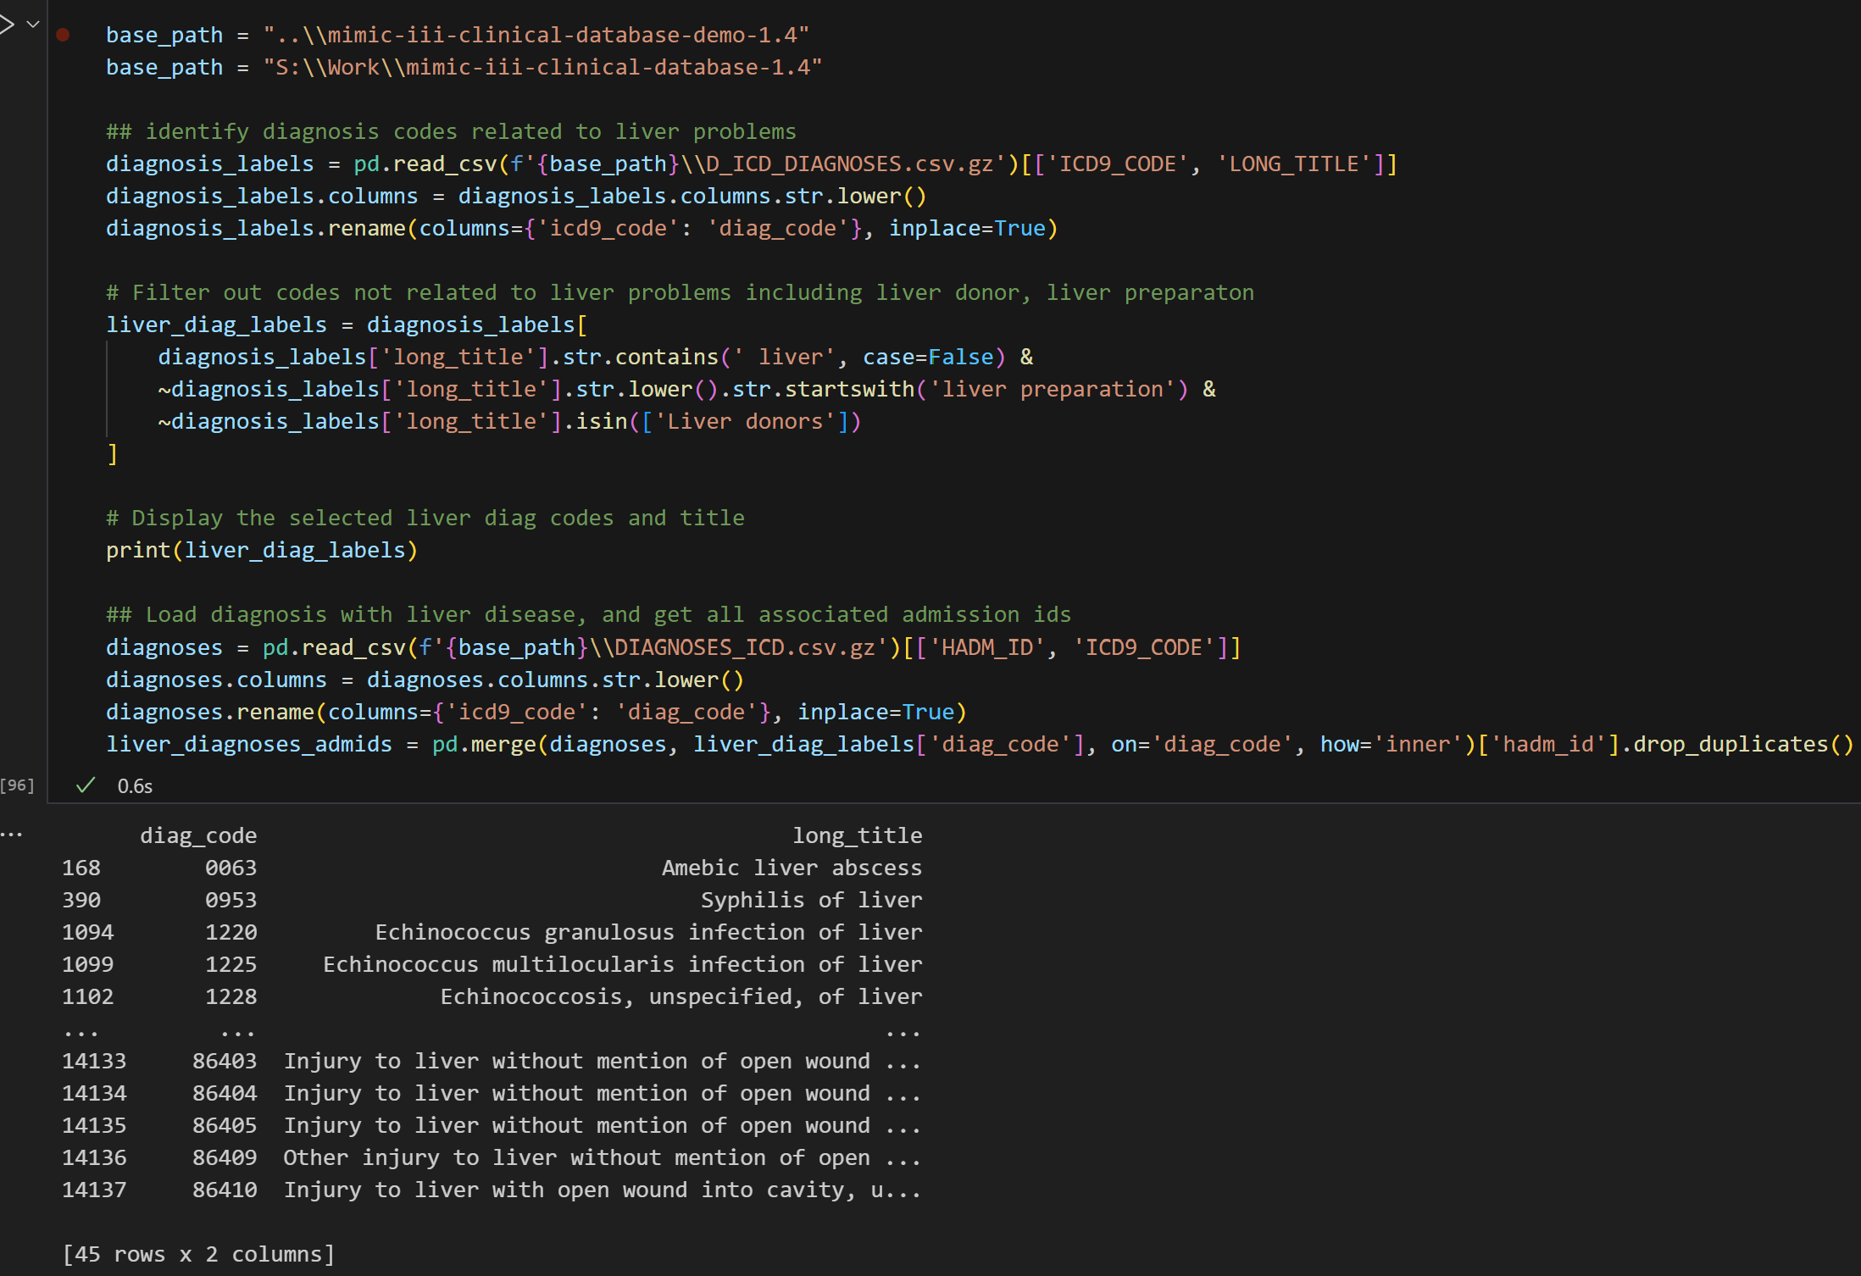
LOAD liver diseases diag code and associated admissions
Load diagnosis code and its corresponding title
Get liver related diseases and filter out non-disease including liver preparation and liver donors
Based on identified icd9 code, save admission ids to be associated with other data

Slide 4
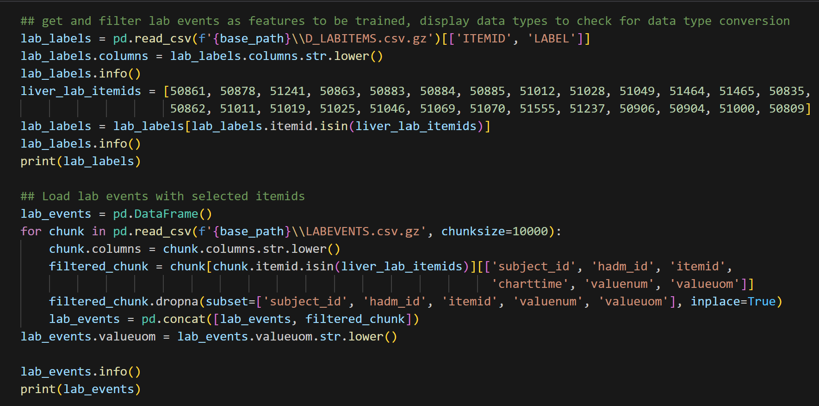
LOAD lab events by chunk related to liver
Lab event itemids are identified and loaded with their associated labels
All lab events are loaded by chunk, within each chunk, only the selected itemids are kept to reduce the size of the whole lab events dataset
Only selected columns are kept as well, also to keep dataset small

Slide 5
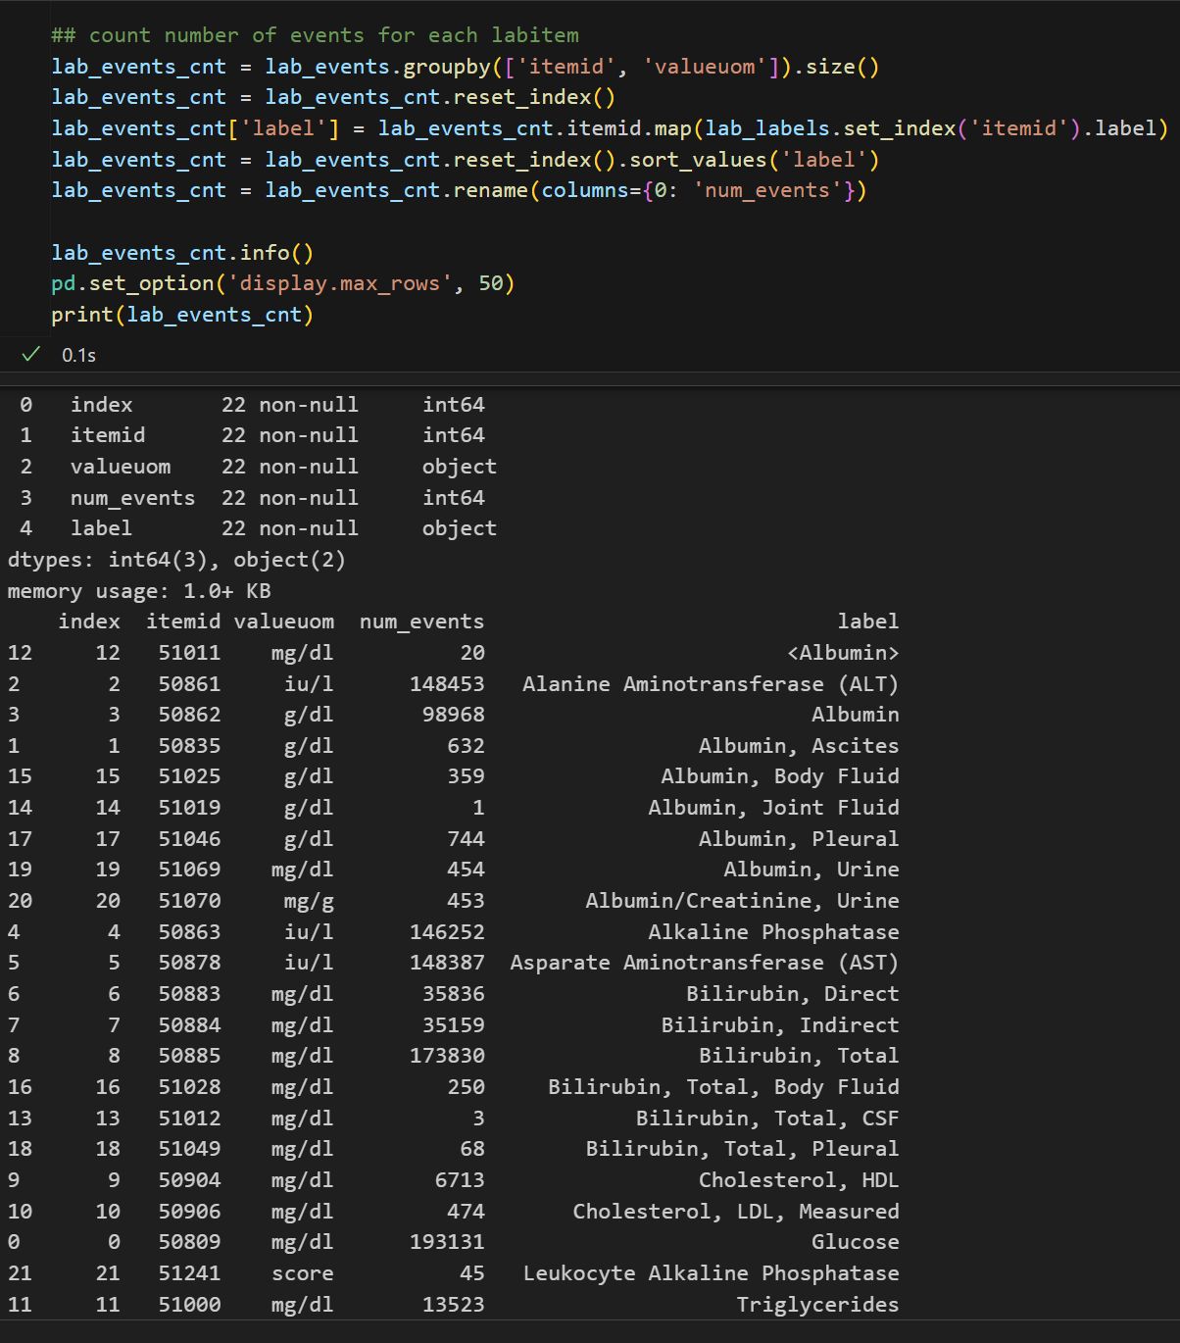
Count lab events
Based on itemid and unit of measure, count number of rows from lab events
Join with labels to display result sorted by labels

Slide 6
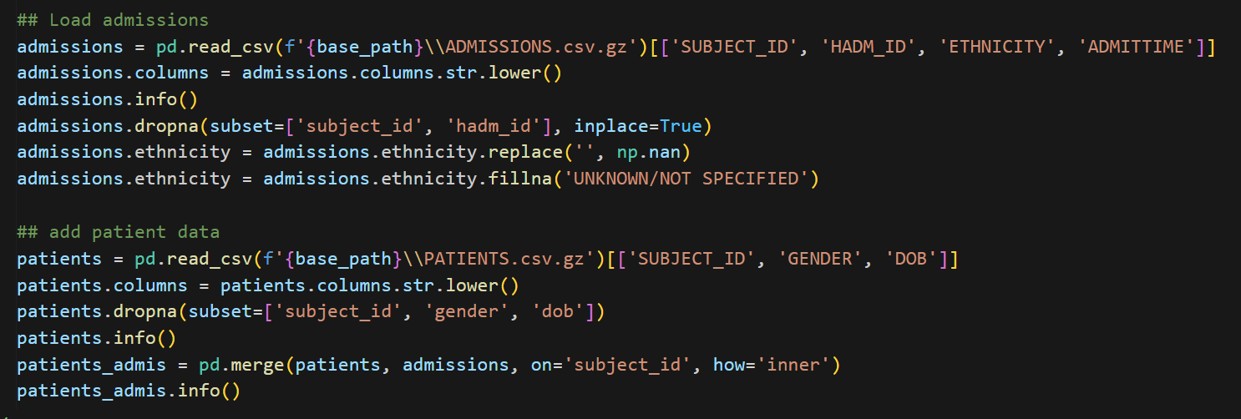
Load admissions and patients
Read admission data replacing missing data by “UNKNOWN”
Read patients data with date of birth and gender
Join admission and patient data

Slide 7
Load admissions and patients
Read admission data replacing missing data by “UNKNOWN”
Read patients data with date of birth and gender
Join admission and patient data

Slide 8
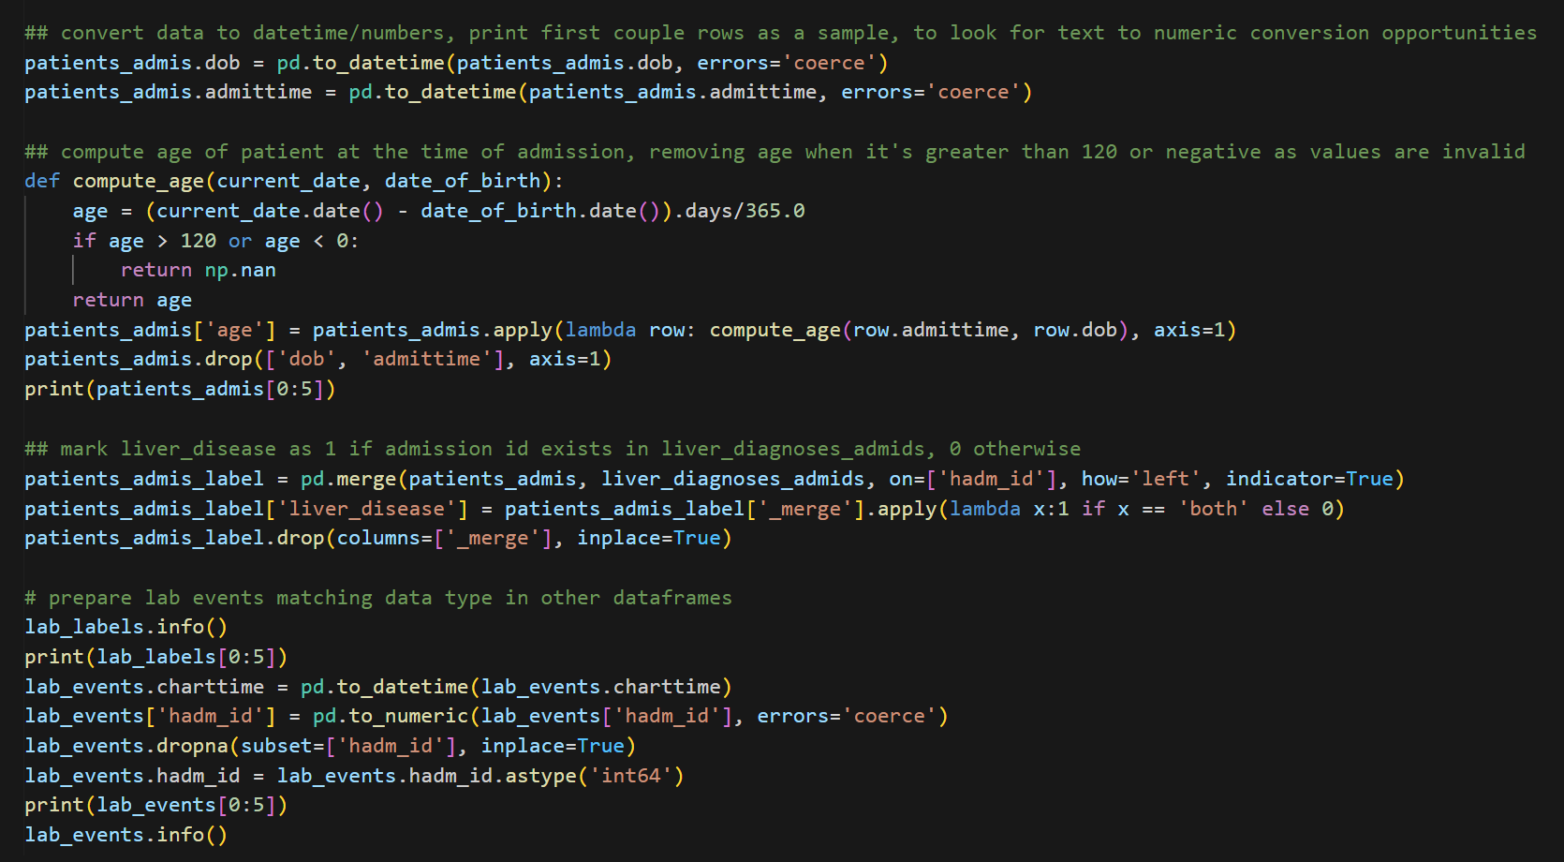
Format admissions and patients
Convert datatime fromstring to datetime
Compute age of patient at time of admission by getting difference between admission date and date of birth after converting them to dates
Any age that is negative or greater than 120 are replaced by nan
Dataset above is joined with liver admission ids with liver related diagnoses codes
If a match is found, row is marked as liver disease = 1, 0 otherwise
Lab events columns are casted to match the dataset above for further processing

Slide 9
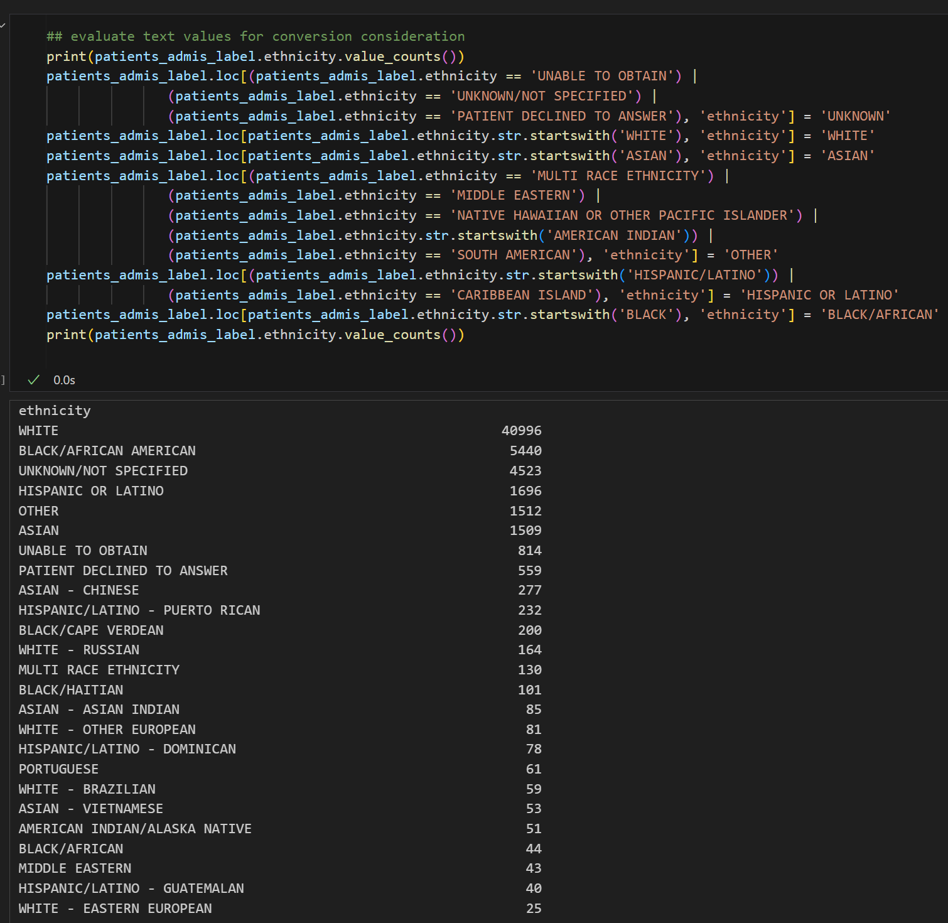
Combine patient’s ehtnicity
Count number of rows by ethnicity
Combine the ethnicities that look similar, replacing those with small counts by the most similar one
Do count again to verify

Slide 10
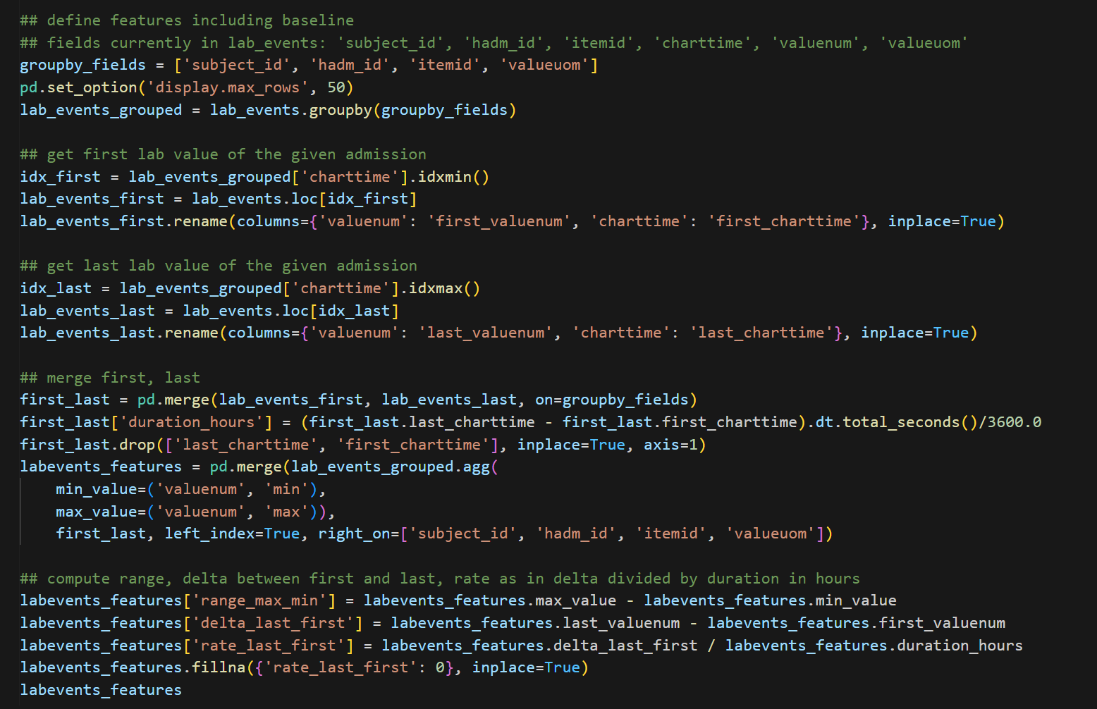
Compute lab events features
Since each admission can include multiple lab events for the same kind, they should be grouped together, so that one row matches one diagnosis of liver disease
Due to each lab value can have a different unit of measure even for the same measurement, the group by should include unit of measure
For each group, identify first, last, min, max of each lab even
Gets the difference between first and last as delta, min and max as range, time of first and time of last as duration
Compute rate dividing delta by duration in hours

Slide 11
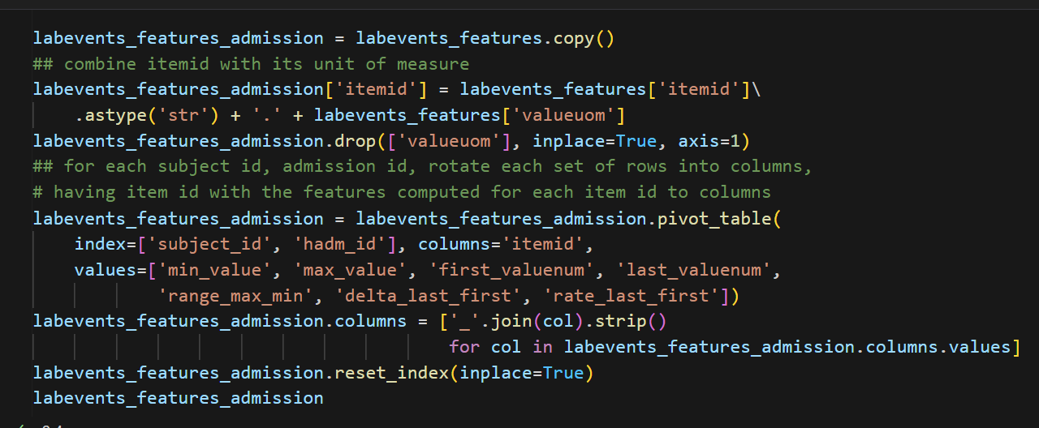
Set features for each lab events to columns
For each subject id, admission id, rotate each lab event to columns, so that all the features computed earlier become a column for a subject’s admission

Slide 12
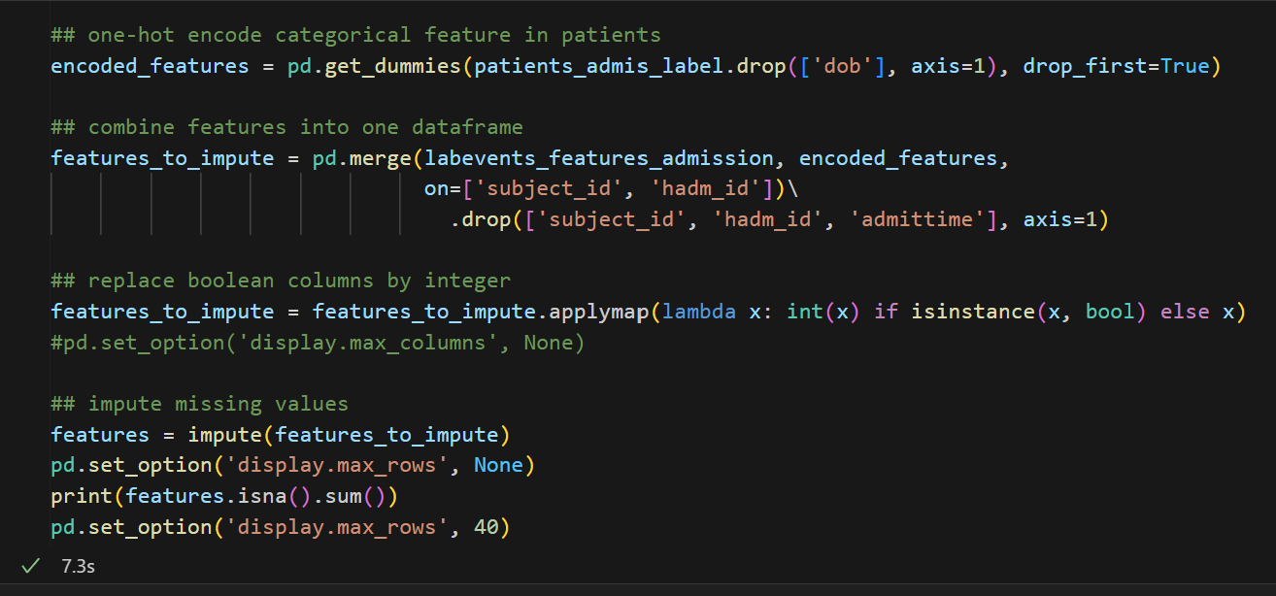
Onehot encode and impute
Hot encode categorical features
Combine earlier datasets with lab events, admissions, and patients data
Replace Boolean with integer
Impute numerical value features
Check for missing values

Slide 13
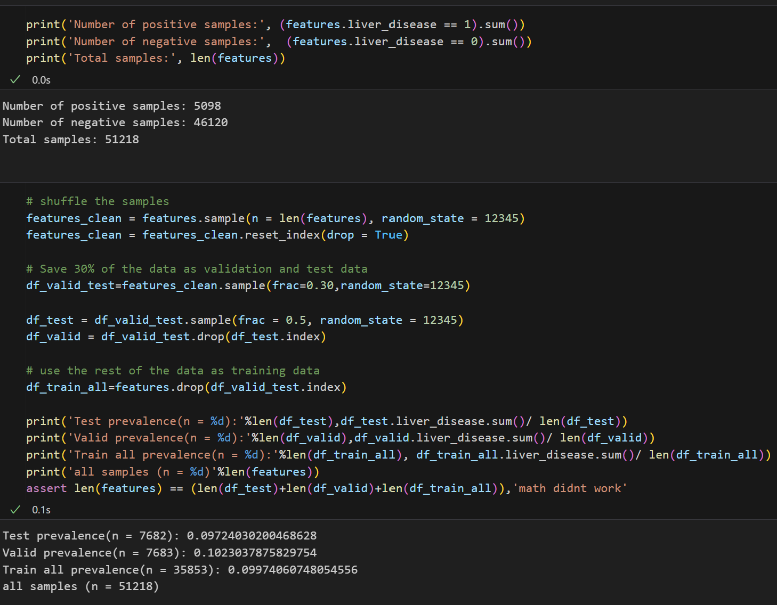
Train, validate, test data set
Check full dataset prevalence by counting positive and negative samples
Randomly extract data as test set and validation set, marking the rest as training set
Compute prevalence for each set

Slide 14
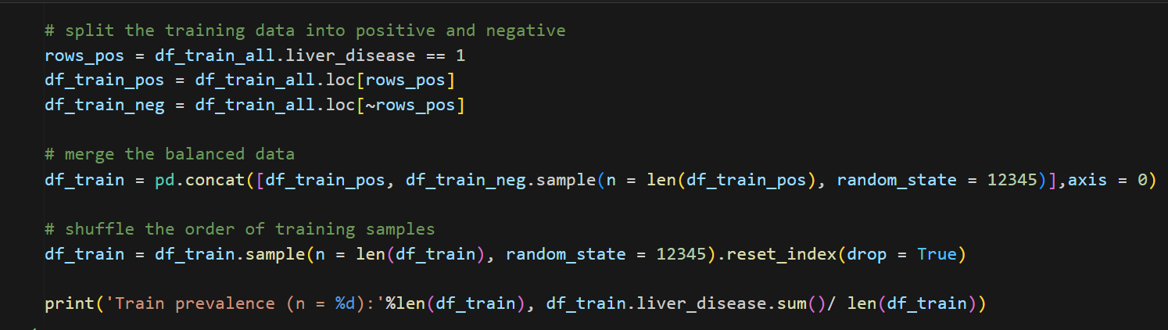
Prevalence setup
Drop negative samples, so that row count for positive matches negative to achieve 0.5 prevalence in training set

Slide 15
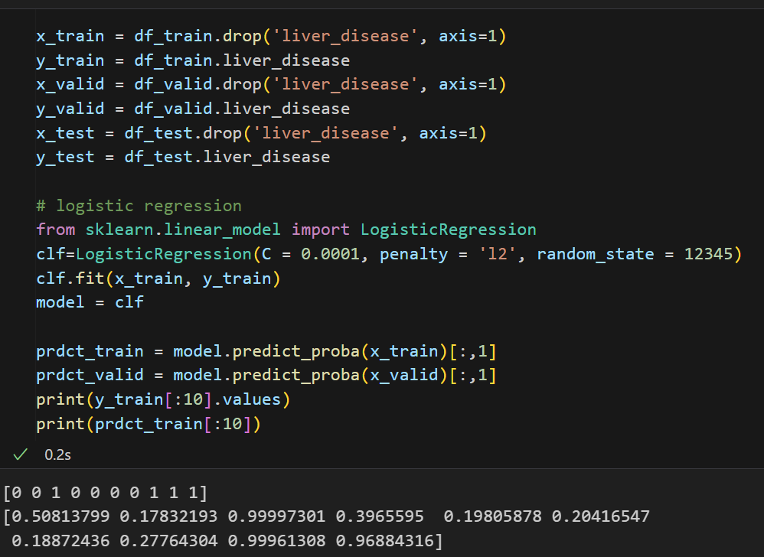
Logistic regression
Use logistic regression to train and validate, printing out prediction result of the first 10 samples

Slide 16
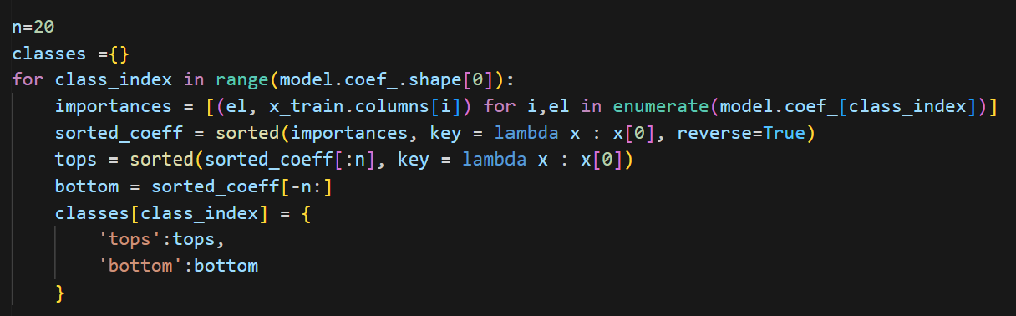
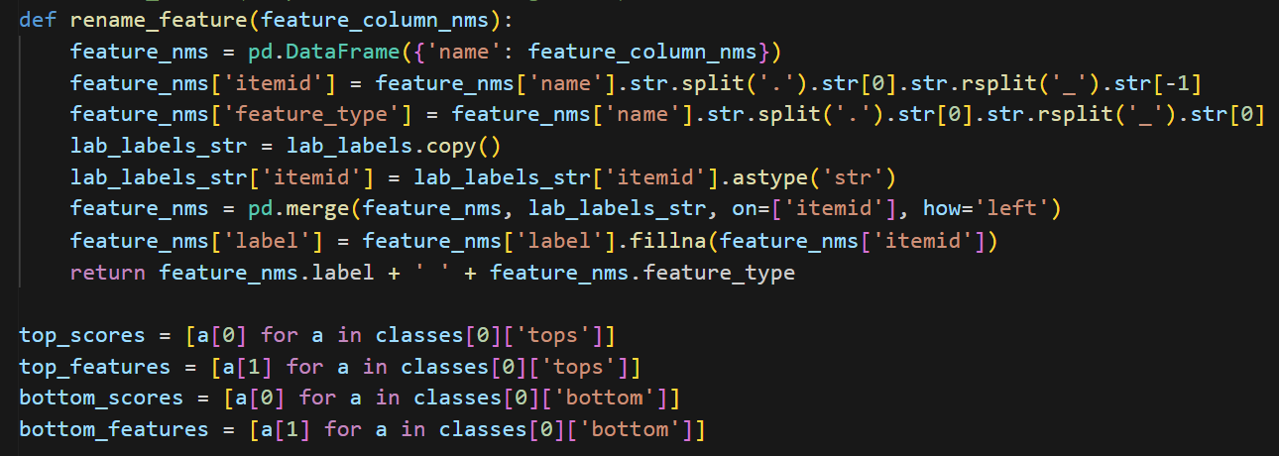
Features importance evaluation
From the logistic regression trained model, identify top 20 highest and lowest features
Rename the feature columns with itemid to its labels

Slide 17
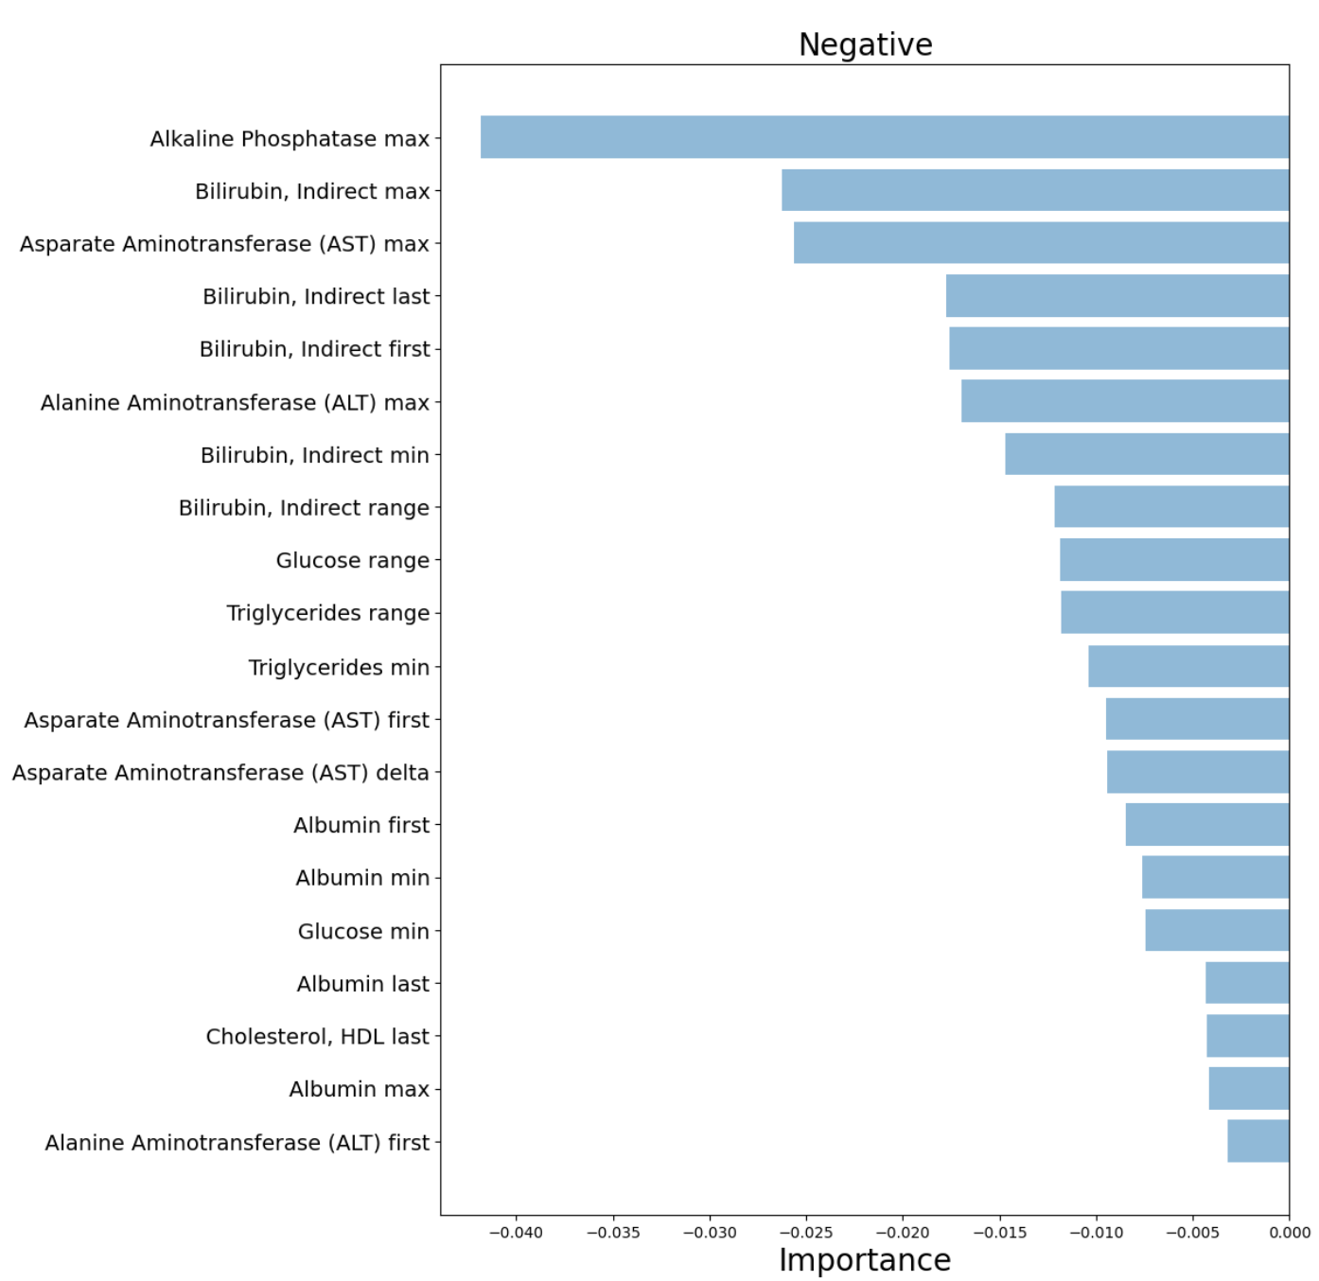
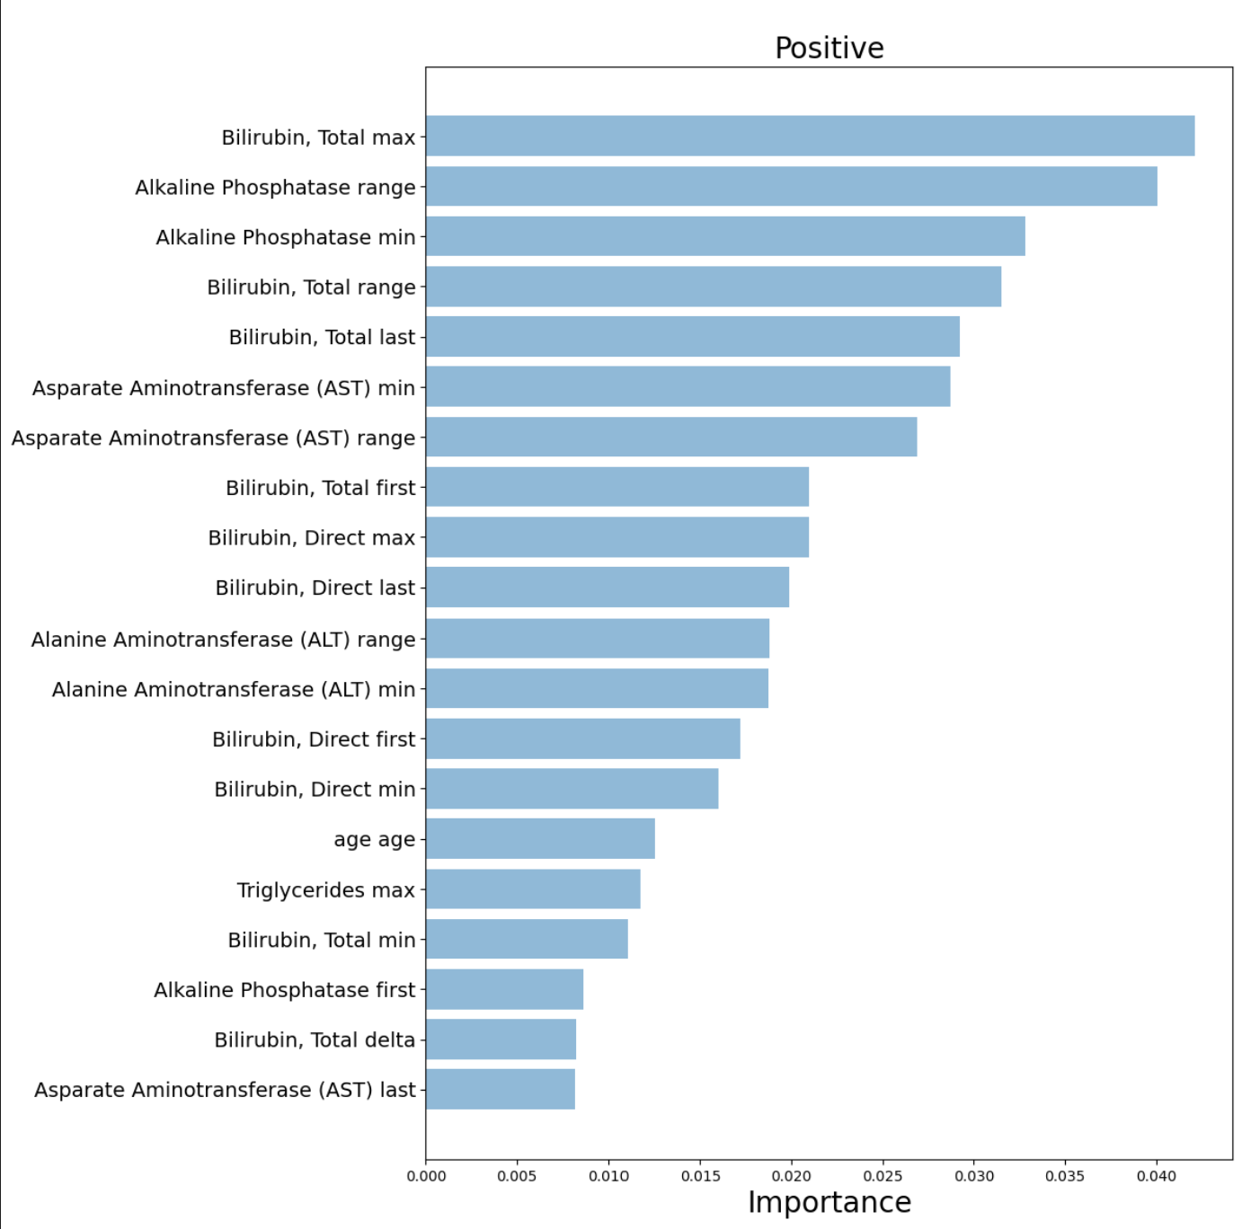
Features importance

Slide 18
Logistic regression
Use logistic regression to train and validate, printing out prediction result of the first 10 samples

Slide 19
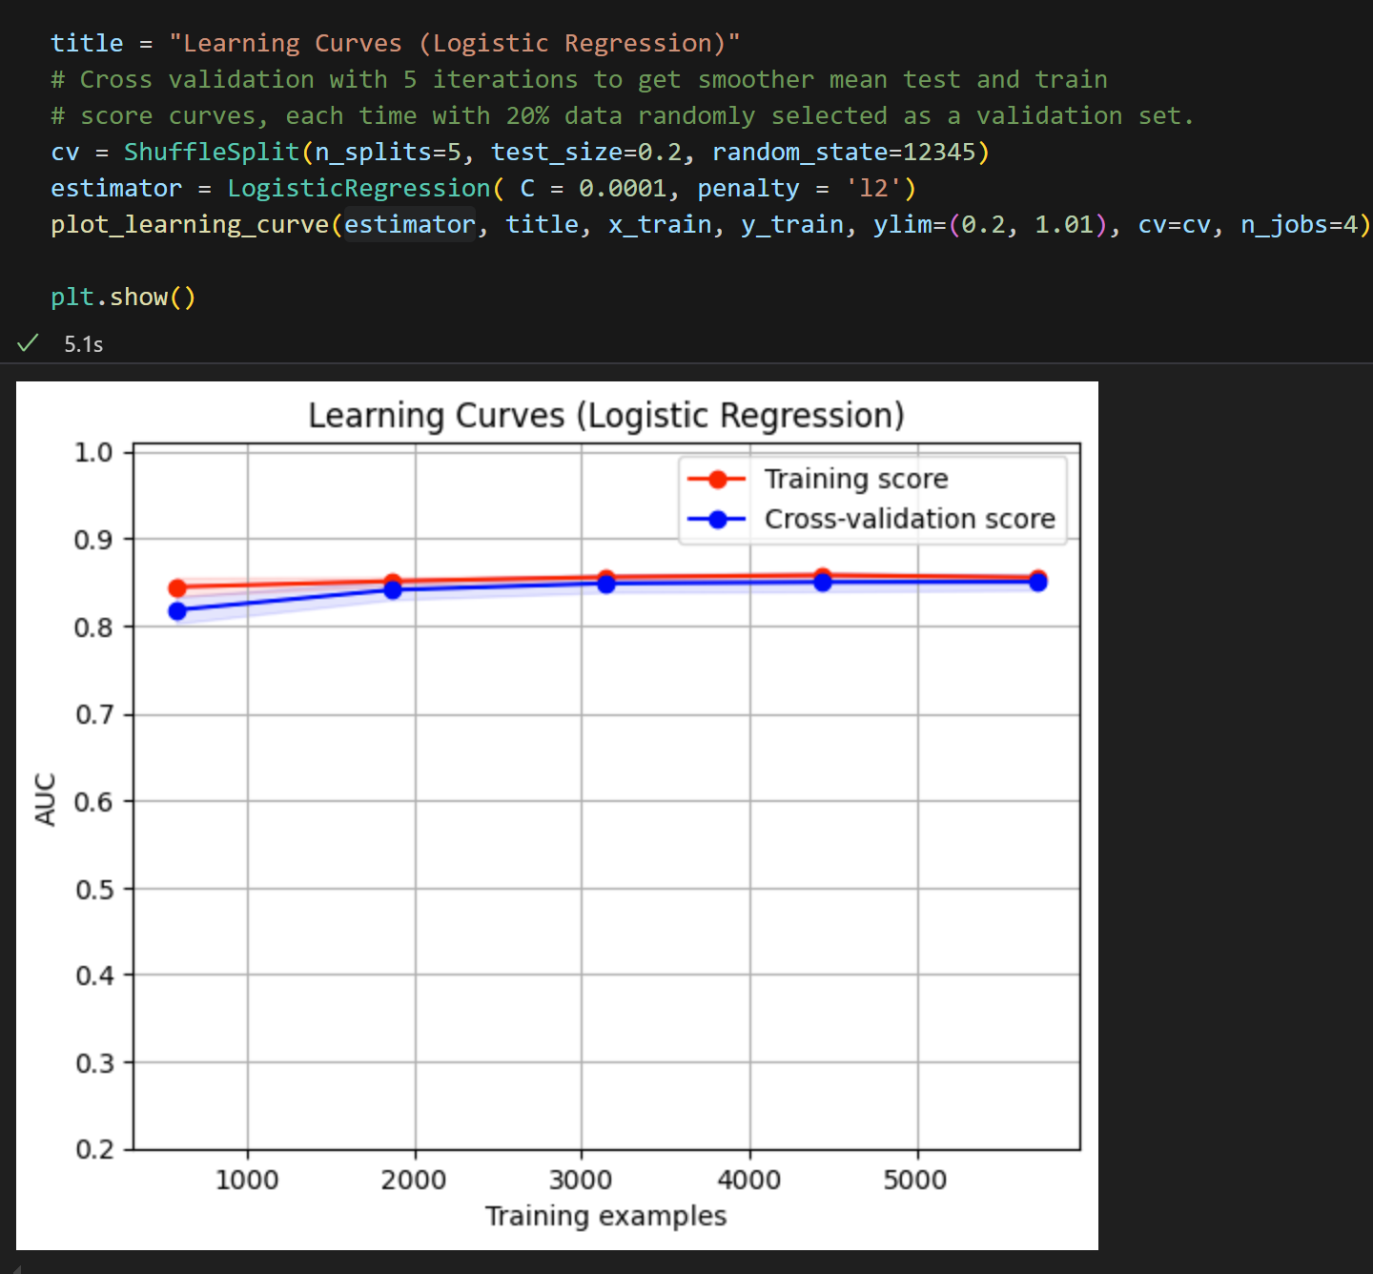
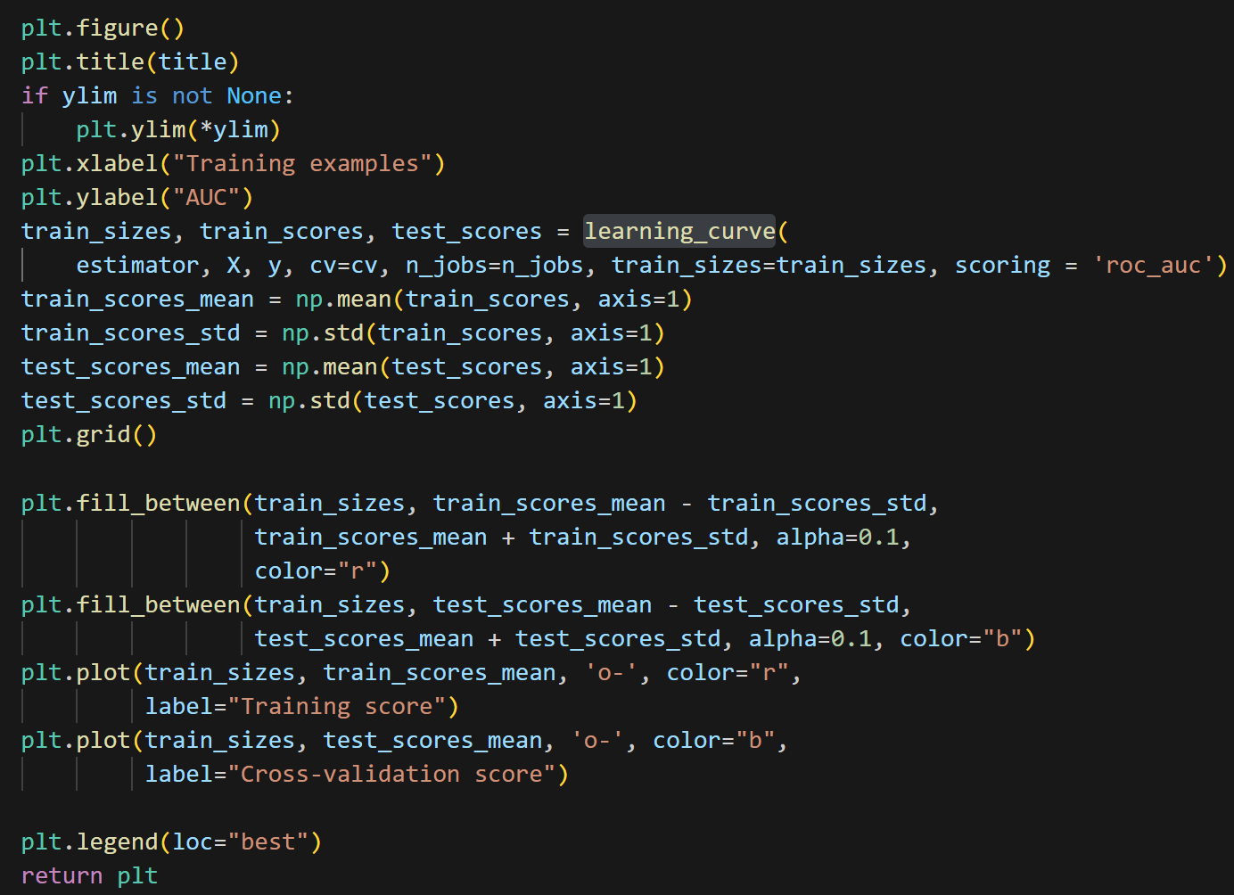
Learning curve
Utilize sklearn model selection learning_curve function to identify number of samples impact to roc

Slide 20
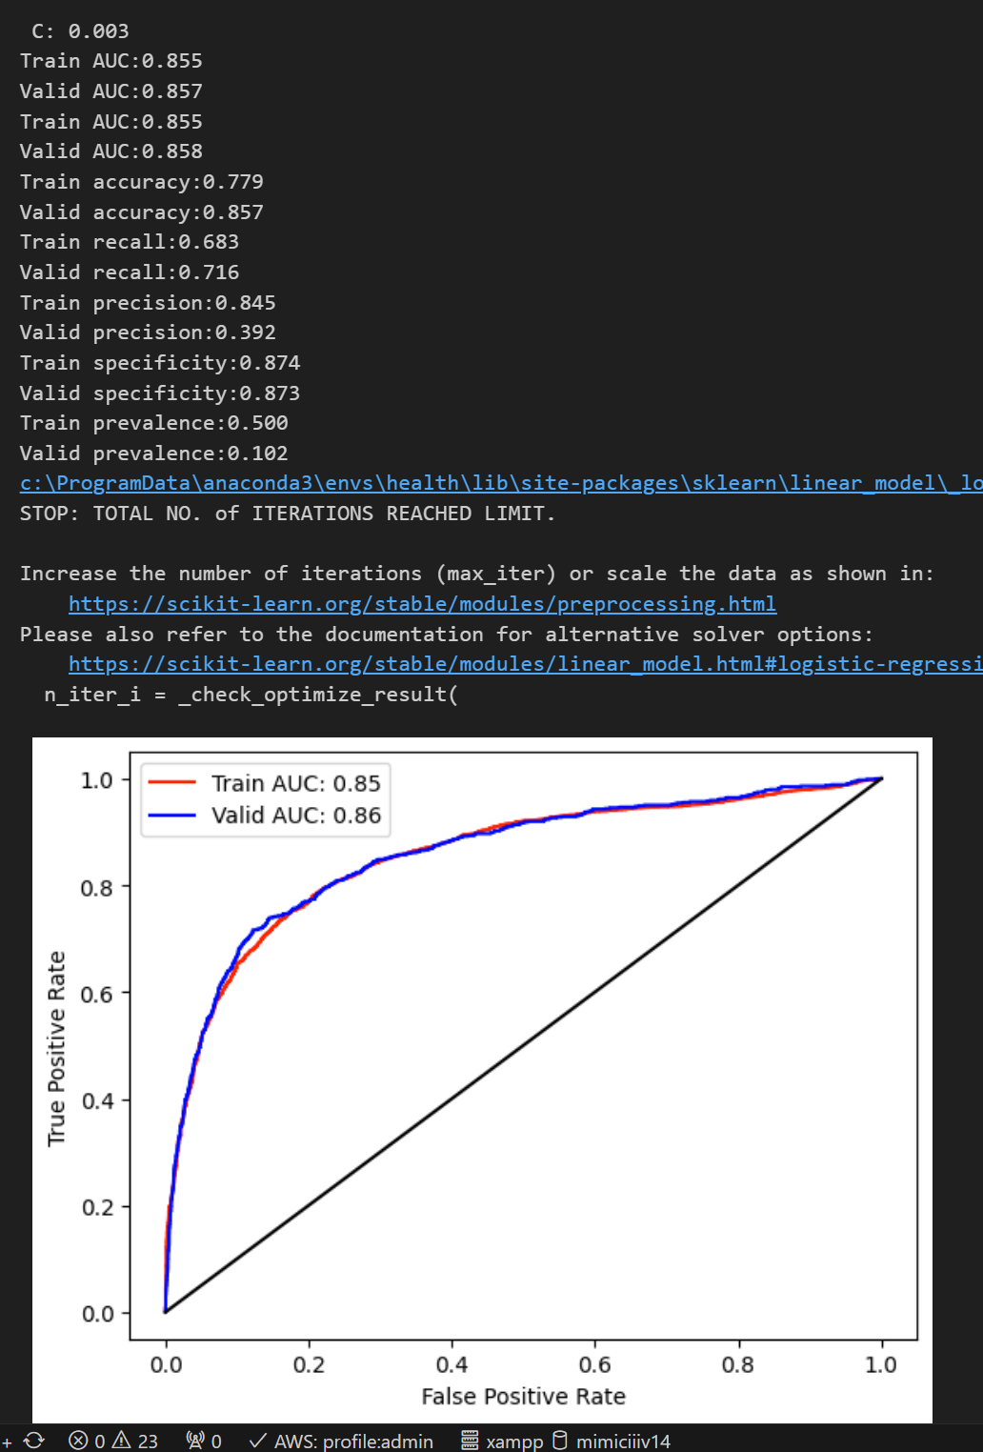
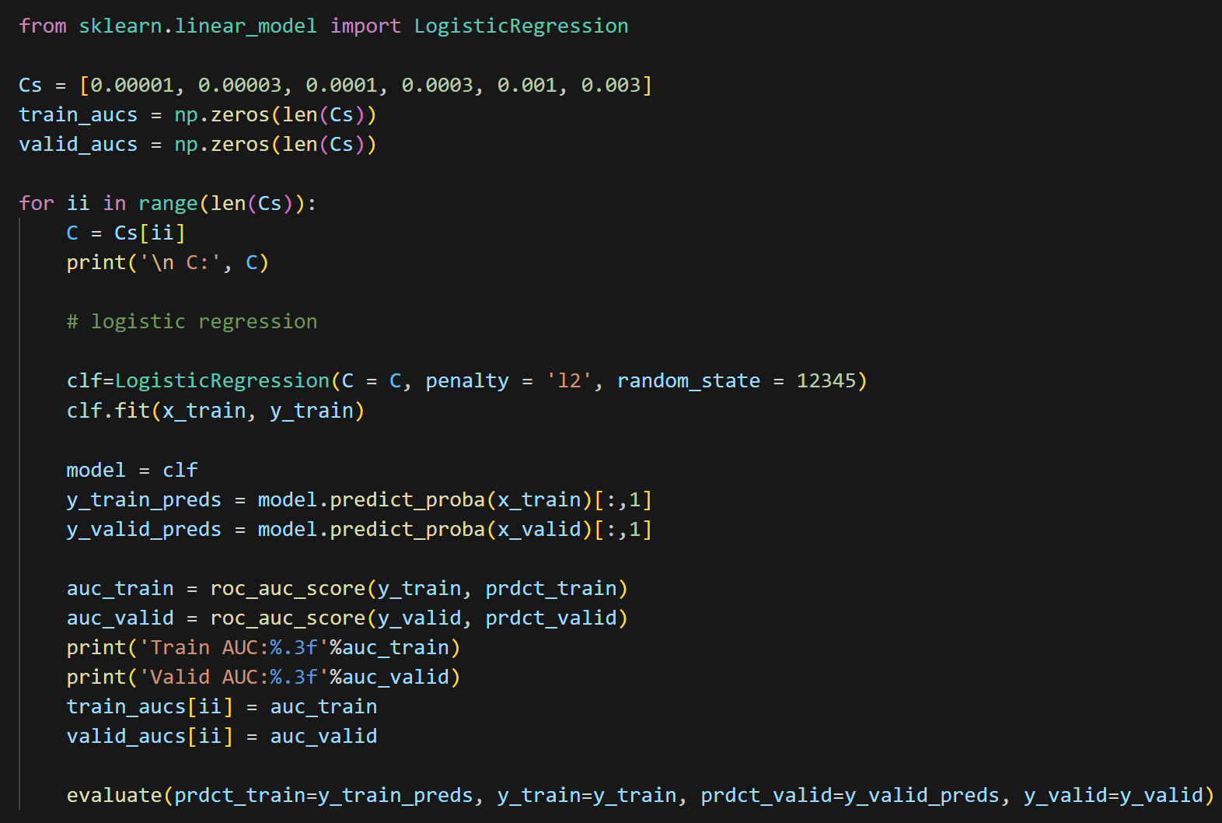
Logistic regression parameters
Compare result of logistic regression given different parameters

Slide 21
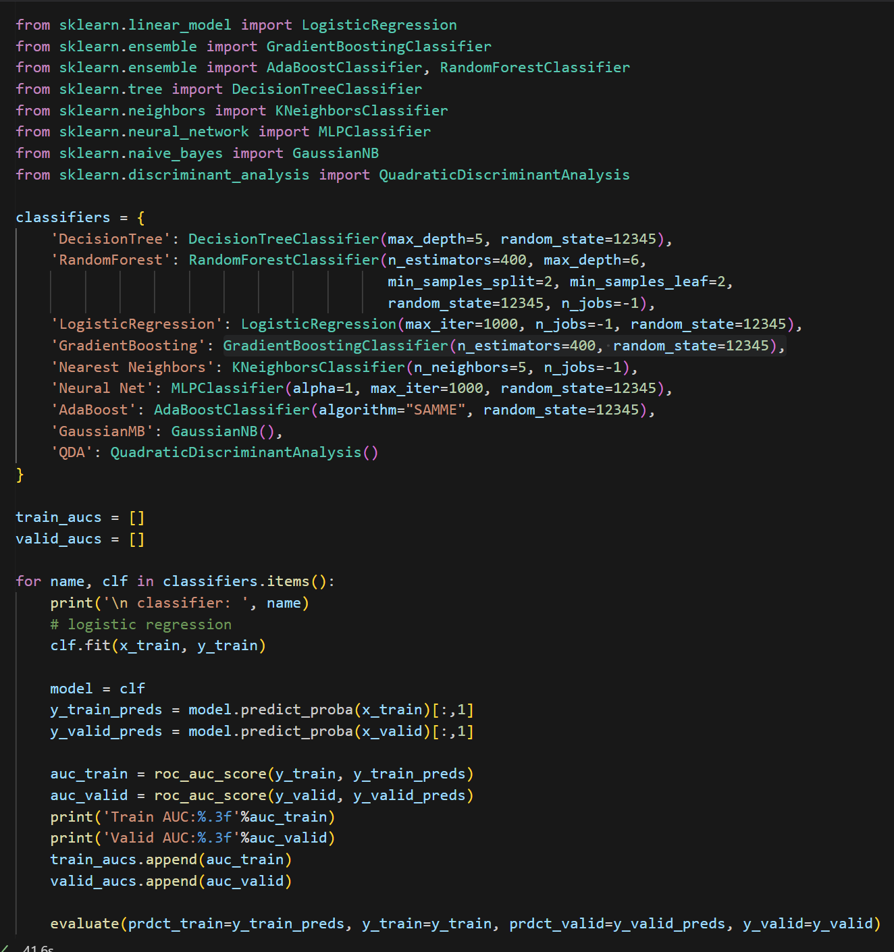
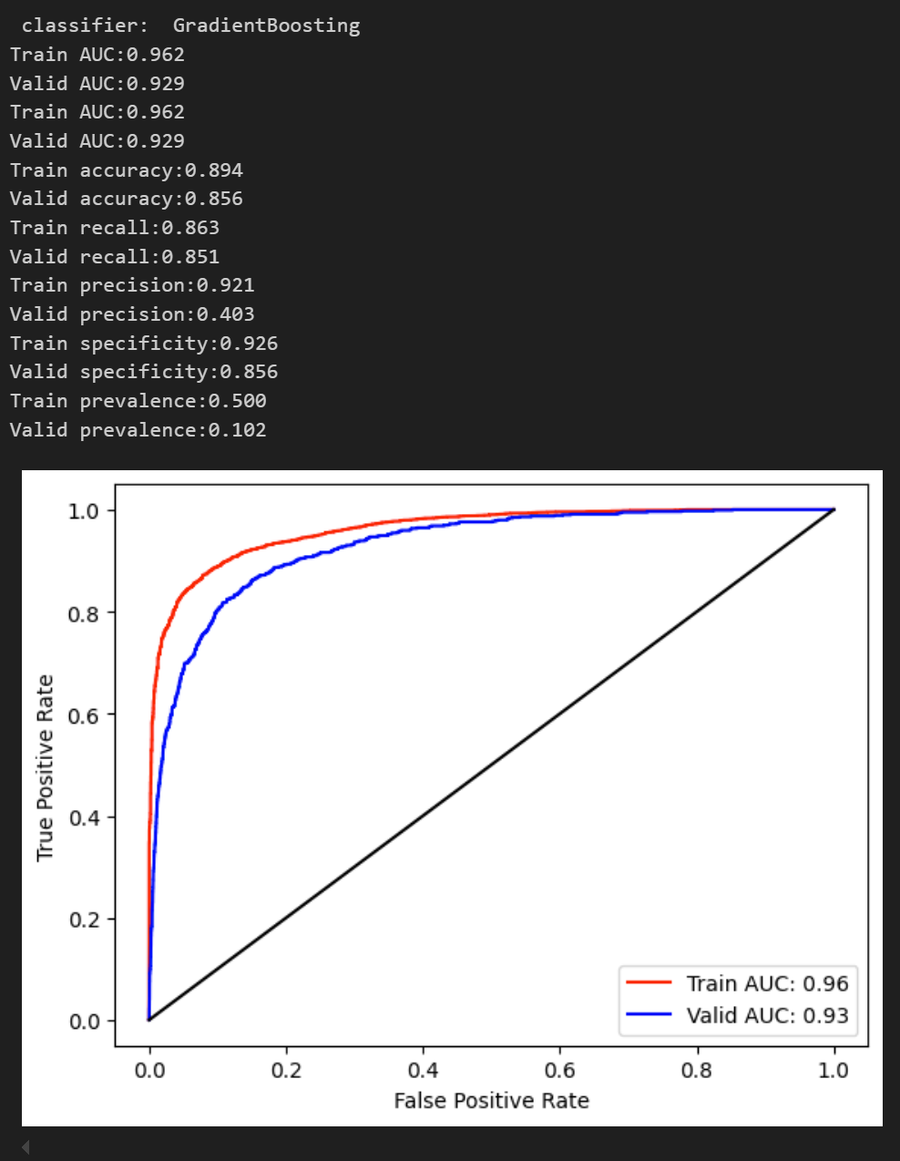
Setup other classifiers
Setup other classifiers and evaluate result of each

Slide 22
Logistic regression
Use logistic regression to train and validate, printing out prediction result of the first 10 samples

Slide 23
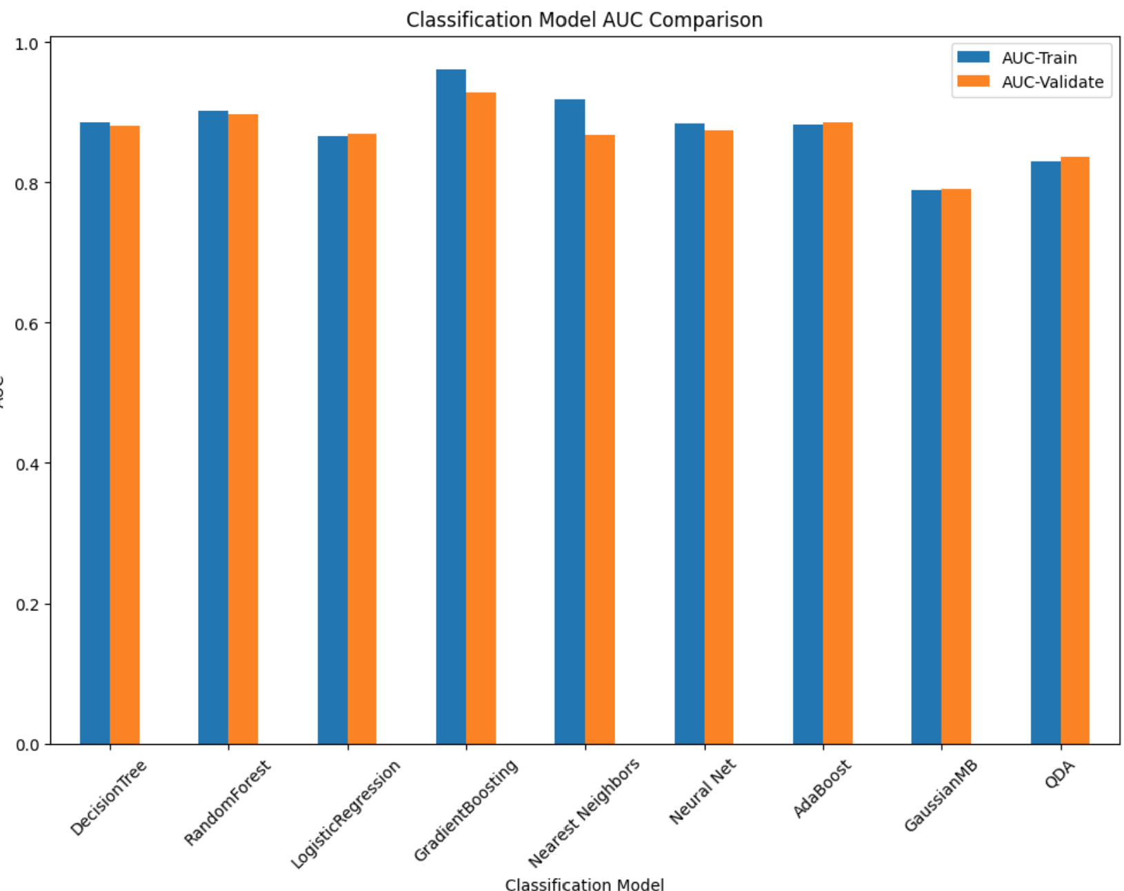
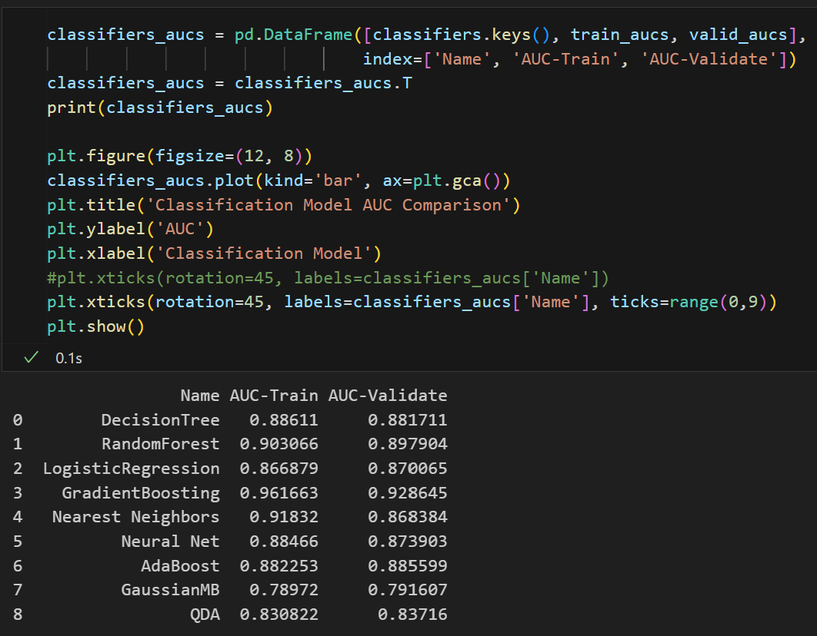
Classifiers auc compare
Compare auc among classifiers

Slide 24
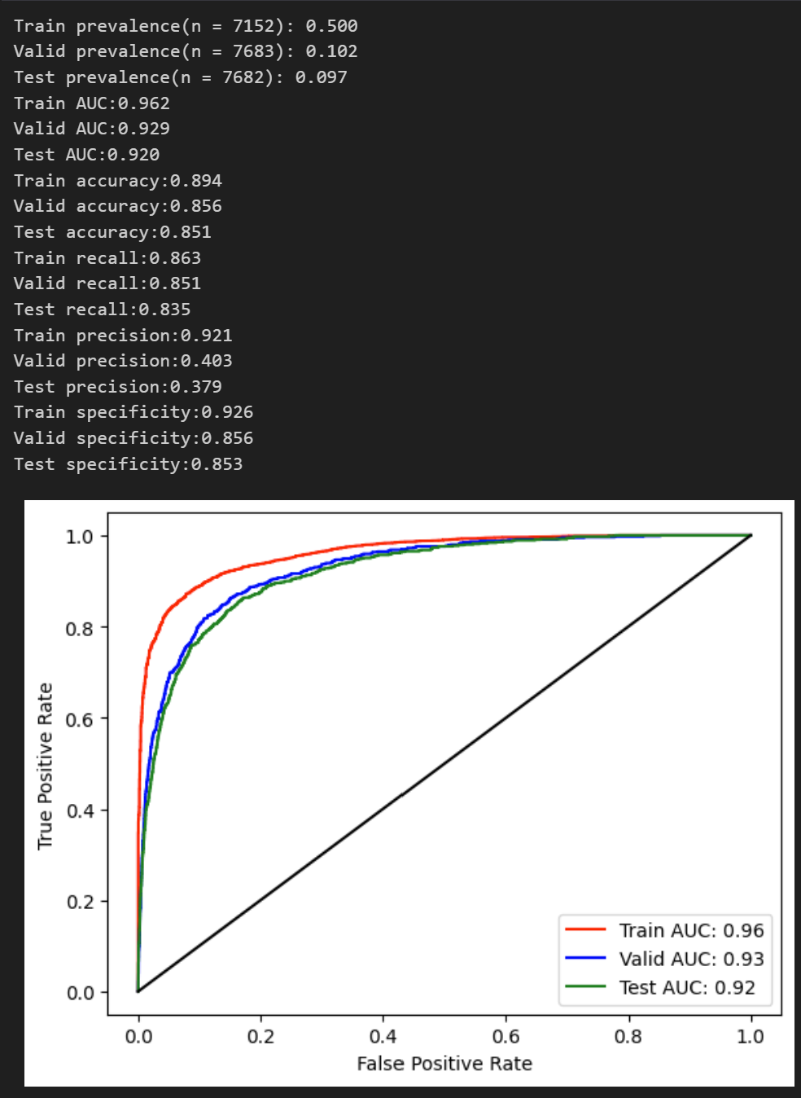
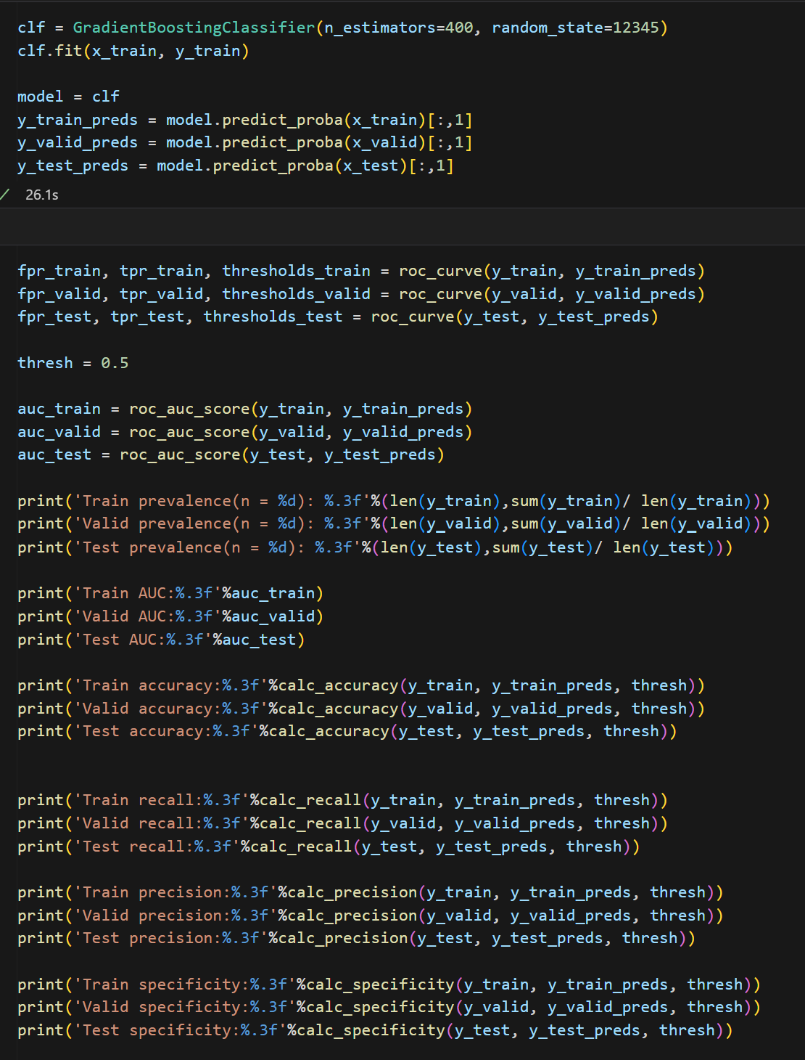
Final model evaluation
Since gradient boosting has the highest score, it is selected as the final model with train, validate, and test set evaluated

